Slide 1
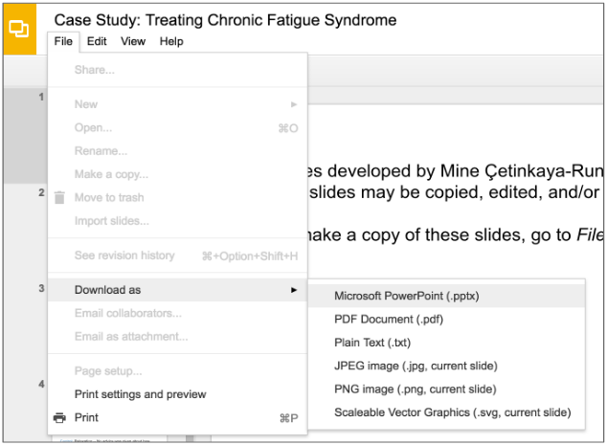
Slides developed by Mine Çetinkaya-Rundel of OpenIntro.
Translated from LaTeX to Google Slides by Curry Hilton of OpenIntro.
The slides may be copied, edited, and/or shared via the CC BY-SA license.
To make a copy of these slides, go to File > Download as > [option], as shown below. Or if you are logged into a Google account, you can choose Make a copy... to create your own version in Google Drive.

Slide 2
Data Basics

Slide 3
Classroom survey
A survey was conducted on students in an introductory statistics course. Below are a few of the questions on the survey, and the corresponding variables the data from the responses were stored in:
gender: What is your gender?
intro_extra: Are you an introvert or an extrovert?
sleep: How many hours do you sleep at night, on average?
bedtime: What time do you usually go to bed?
countries: How many countries have you visited?
dread: On a scale of 1-5, how much do you dread being here?

Slide 4
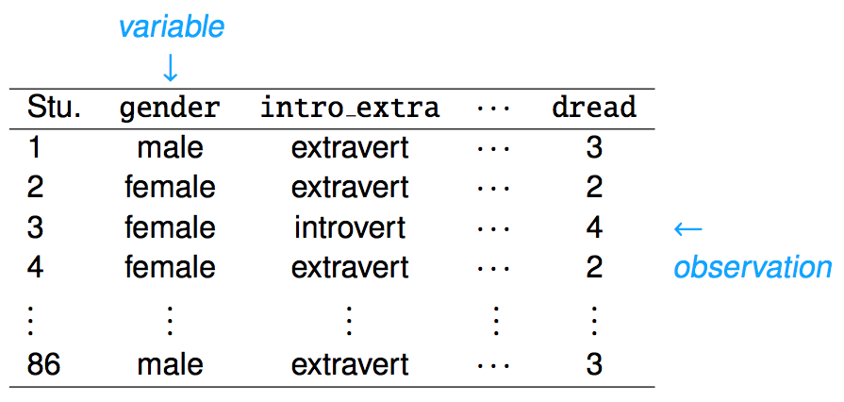
Data matrix
Data collected on students in a statistics class on a variety of variables:

Slide 5
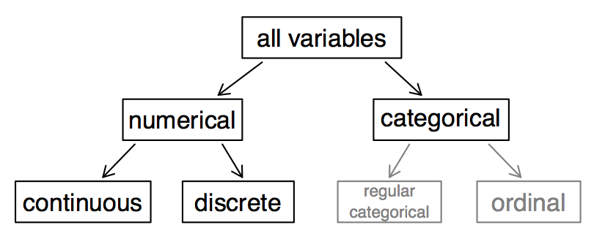
Types of variables

Slide 6
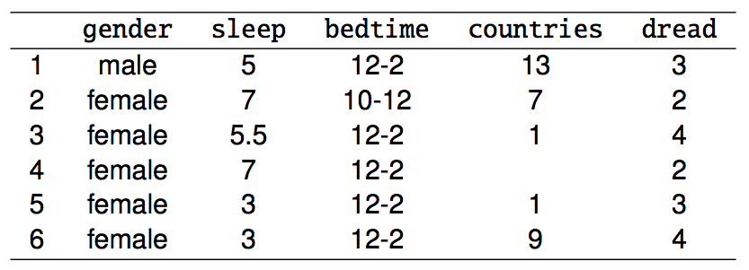
Types of variables (cont.)
gender:

Slide 7
Types of variables (cont.)
gender: categorical

Slide 8
Types of variables (cont.)
gender: categorical
sleep:

Slide 9
Types of variables (cont.)
gender: categorical
sleep: numerical, continuous

Slide 10
Types of variables (cont.)
gender: categorical
sleep: numerical, continuous
bedtime:

Slide 11
Types of variables (cont.)
gender: categorical
sleep: numerical, continuous
bedtime: categorical, ordinal

Slide 12
Types of variables (cont.)
gender: categorical
sleep: numerical, continuous
bedtime: categorical, ordinal
countries:

Slide 13
Types of variables (cont.)
gender: categorical
sleep: numerical, continuous
bedtime: categorical, ordinal
countries: numerical, discrete

Slide 14
Types of variables (cont.)
gender: categorical
sleep: numerical, continuous
bedtime: categorical, ordinal
countries: numerical, discrete
dread:

Slide 15
Types of variables (cont.)
gender: categorical
sleep: numerical, continuous
bedtime: categorical, ordinal
countries: numerical, discrete
dread: categorical, ordinal - could also be used as numerical

Slide 16
Practice
What type of variable is a telephone area code?
(a) numerical, continuous
(b) numerical, discrete
(c) categorical
(d) categorical, ordinal

Slide 17
Practice
What type of variable is a telephone area code?
(a) numerical, continuous
(b) numerical, discrete
(c) categorical
(d) categorical, ordinal

Slide 18
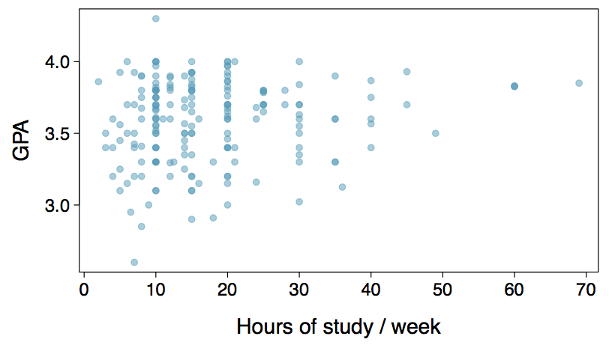
Relationships among variables
Does there appear to be a relationship between the hours of study per week and the GPA of a student?

Slide 19
Relationships among variables
Does there appear to be a relationship between the hours of study per week and the GPA of a student?
Can you spot anything unusual about any of the data points?

Slide 20
Relationships among variables
Does there appear to be a relationship between the hours of study per week and the GPA of a student?
Can you spot anything unusual about any of the data points?
There is one student with GPA > 4.0, this is likely a data error.
Notes:
Thanks to Nelson Gomez for catching a typo on this slide!

Slide 21
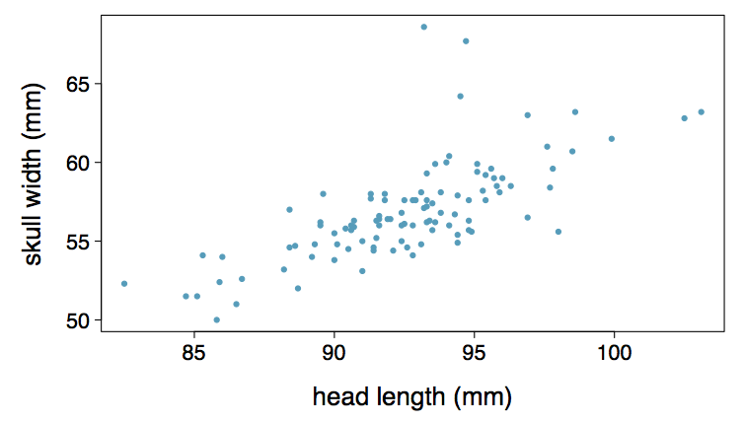
Practice
Based on the scatterplot on the right, which of the following statements is correct about the head and skull lengths of possums?
(a) There is no relationship between head length and skull width,
i.e. the variables are independent.
(b) Head length and skull width are positively associated.
(c) Skull width and head length are negatively associated.
(d) A longer head causes the skull to be wider.
(e) A wider skull causes the head to be longer.

Slide 22
Practice
Based on the scatterplot on the right, which of the following statements is correct about the head and skull lengths of possums?
(a) There is no relationship between head length and skull width,
i.e. the variables are independent.
(b) Head length and skull width are positively associated.
(c) Skull width and head length are negatively associated.
(d) A longer head causes the skull to be wider.
(e) A wider skull causes the head to be longer.

Slide 23
Associated vs. independent
When two variables show some connection with one another, they are called associated variables.
Associated variables can also be called dependent variables and vice-versa.
If two variables are not associated, i.e. there is no evident connection between the two, then they are said to be independent.

Slide 24
Find more resources at openintro.org/os, including
Slides
Videos
Statistical Software Labs
Discussion Forums (free support for students and teachers)
Learning Objectives
Teachers only content is also available for Verified Teachers, including
Exercise solutions
Sample exams
Ability to request a free desk copy for a course
Statistics Teachers email group
Questions? Contact us.

